Slide 1
Unix/Linux-Based Operating System
Introduction to UNIX/Linux
Reference Site: https://www.tutorialspoint.com/unix/index.htm
Source Website: https://www.hpc.iastate.edu/guides/unix-introduction
1. Unix / Linux - Home
Unix / Linux - What is Linux?
Unix / Linux - Getting Started
Unix / Linux - File Management
Unix / Linux - Directories
Unix / Linux - File Permission
Unix / Linux - Environment
Unix / Linux - Basic Utilities
Unix / Linux - Pipes & Filters
Unix / Linux - Processes
Unix / Linux - Communication
Unix / Linux - The vi Editor
Unix / Linux - Shell Scripting
Unix / Linux - What is Shell?
Unix / Linux - Using Variables
Unix / Linux - Special Variables
Unix / Linux - Using Arrays
Unix / Linux - Basic Operators
Unix / Linux - Decision Making
Unix / Linux - Shell Loops
Unix / Linux - Loop Control
Unix / Linux - Shell Substitutions
Unix / Linux - Quoting Mechanisms
Unix / Linux - IO Redirections
Unix / Linux - Shell Functions
Unix / Linux - Manpage Help

Slide 2
QN: Why is a Command-Line Interface (CLI)-based operating system generally faster and more efficient than a Graphical User Interface (GUI)-based system? What are the main benefits of using a CLI-based OS for remote access and automation?
A Command-Line Interface (CLI)-based operating system is generally faster and more efficient than a Graphical User Interface (GUI)-based system due to several key reasons:
Lower Resource Consumption
  CLI-based systems do not require a graphical environment, reducing the need for RAM, CPU power, and storage.
  GUIs demand additional processes for rendering windows, icons, animations, and other visual elements, which increase system overhead.
Faster Execution
  Commands in CLI are executed directly without needing multiple clicks or navigating through menus.
  A well-optimized CLI workflow can automate repetitive tasks efficiently using scripts.
Greater Stability and Reliability
  Since CLIs do not rely on a GUI layer, they are less prone to crashes and system slowdowns.
  CLI-based OSs are widely used in servers and embedded systems where uptime and stability are critical.
Efficient System Management
  CLI provides fine-grained control over the system, making tasks like network configuration, user management, and file manipulation more efficient.
  Remote administration is faster as it does not require graphical rendering.

Slide 3
Main Benefits of Using a CLI-Based OS for Remote Access and Automation
Lightweight Remote Access
  CLI allows remote access using SSH (Secure Shell), which consumes minimal bandwidth compared to GUI-based remote desktop solutions.
  Users can perform system management and troubleshooting from virtually anywhere without needing a graphical interface.
Powerful Automation
  CLI supports scripting (e.g., Bash, PowerShell, Python) to automate tasks like software updates, log analysis, backups, and deployments.
  Automation minimizes human errors and increases productivity.
Security Advantages
  CLI-based access is generally more secure as it reduces the attack surface compared to GUI-based tools that may require open ports for remote desktops (e.g., RDP or VNC).
  Scripts and commands can be executed with privileged access control without exposing unnecessary graphical components.
Scalability for System Administration
  CLI allows managing multiple remote servers simultaneously using tools like Ansible, SSH scripts, and cron jobs.
  System administrators can deploy updates, modify configurations, or troubleshoot issues across hundreds of machines efficiently.
Types of UNIX or Linux-based Operating Systems:
1. Traditional UNIX Systems
These are based on the original UNIX source code.
AIX (Advanced Interactive eXecutive) – Developed by IBM
HP-UX (Hewlett Packard UNIX) – Developed by Hewlett-Packard

Slide 4
Solaris (now OpenIndiana) – Originally from Sun Microsystems
🔹 2. Linux Distributions (Linux Distros)
These are open-source UNIX-like systems built around the Linux kernel.
Desktop/General-Purpose Distros
Ubuntu – User-friendly, great for beginners
Linux Mint – Based on Ubuntu; lightweight and beginner-friendly
Fedora – Cutting-edge technologies, backed by Red Hat
Debian – Known for stability and free software
Arch Linux – Lightweight and highly customizable
Zorin OS – Designed for Windows users switching to Linux
Enterprise/Server Distros
Red Hat Enterprise Linux (RHEL) – Commercial, used in enterprise servers
CentOS / CentOS Stream – Previously a free version of RHEL (now replaced by CentOS Stream)
Rocky Linux / AlmaLinux – RHEL-compatible replacements for CentOS
SUSE Linux Enterprise Server (SLES) – Used in business environments
Penetration Testing / Hacking / Security Distros

Slide 5
Kali Linux – Security and penetration testing
Parrot OS – Forensics, penetration testing, and privacy
🔹 3. Lightweight Linux Distros
Best for old or low-resource hardware.
Puppy Linux
Lubuntu
Tiny Core Linux
antiX
🔹 4. Special Purpose Distros
Designed for specific uses.
TrueNAS CORE – NAS (Network Attached Storage) server OS (based on FreeBSD, a UNIX-like OS)
Raspberry Pi OS – For Raspberry Pi devices
Tails – Focuses on anonymity and privacy
Ubuntu Server – Lightweight version of Ubuntu for server use
🔹 5. BSD Systems (UNIX-like)

Slide 6
Although not Linux, they are UNIX or UNIX-like.
FreeBSD
OpenBSD
NetBSD
DragonFly BSD

Slide 7
Why We Use Kali Linux in Our Lab
Pre-installed Security Tools
Kali Linux includes a wide range of pre-installed cybersecurity tools used for:
  Penetration testing
  Vulnerability assessment
  Digital forensics
  Wireless attacks
  Password cracking
  Network sniffing
Some commonly used tools in Kali are Nmap, Wireshark, Metasploit, Burp Suite, and John the Ripper. This makes it an ideal platform for hands-on security practice.
Open Source and Free
Kali Linux is completely free and open source. This makes it cost-effective for educational institutions and students.
Widely Used in the Cybersecurity Industry
Kali is one of the most commonly used operating systems among ethical hackers, penetration testers, and cybersecurity professionals. Using it in the lab prepares students with industry-relevant skills.
Customizable and Lightweight
Kali Linux is lightweight and can be run on physical machines, virtual machines (VMs), or through live USBs. This flexibility makes it easy to deploy in a controlled lab environment.

Slide 8
Safe Environment for Ethical Hacking
Kali provides a controlled and isolated environment, allowing students to practice ethical hacking techniques without posing a risk to real-world systems.
Regular Updates and Community Support
Maintained by Offensive Security, Kali Linux receives frequent updates and has strong community support, ensuring students have access to the latest tools and features.

Slide 9
How to Install Kali Linux (Step-by-Step Guide)
Prerequisites
Before you begin, ensure the following:
A computer with at least 2 GB RAM and 20 GB free disk space
Kali Linux ISO (download from https://www.kali.org/get-kali/)
A bootable USB drive (minimum 8 GB) for installation
Optional: VirtualBox/VMware if installing virtually
Back up your important data if you are installing on a physical system
Installation Methods Overview
Installation on Physical System via Bootable USB
Installation in a Virtual Machine
Dual Boot Installation with Windows
Installation Using Bootable USB (Physical System)
Step 1: Download Kali ISO
  Visit: https://www.kali.org/get-kali/

Slide 10
Download the installer image (64-bit recommended)
Step 2: Create Bootable USB
Use Rufus (Windows tool):
Download from https://rufus.ie
Select the USB drive
Select the Kali ISO file
File system: FAT32
Click Start and wait for the process to complete
Step 3: Boot from USB
Restart your PC
Enter the BIOS/Boot Menu (usually by pressing F2, F12, ESC, or DEL)
Select the USB drive as the boot device
Step 4: Start Installation
Choose Graphical Install
Select language, location, and keyboard layout
Step 5: Configure System
Set hostname (e.g., kali)

Slide 11
Set domain name (optional)
Create a new user and password
Step 6: Partition Disk
Use "Guided – Use entire disk" (for full installation)
Write changes to disk and continue
Note: This will erase the entire disk. For dual booting, refer to section 3.
Step 7: Install System and GRUB
Choose to install the GRUB boot loader
Select the appropriate disk (e.g., /dev/sda)
Step 8: Reboot
Remove USB when prompted
Kali Linux is now installed
Installation Using Virtual Machine (e.g., VirtualBox)
Step 1: Install VirtualBox
  Download from https://www.virtualbox.org
Step 2: Create New VM

Slide 12
Name: Kali Linux
Type: Linux → Debian (64-bit)
RAM: At least 2048 MB
Create a new virtual hard disk (20 GB+)
Step 3: Load ISO
Go to Settings → Storage → Mount the Kali ISO
Step 4: Start VM and Install
Follow the same steps as the physical installation
Dual Boot Installation with Windows
Dual booting allows you to run both Windows and Kali Linux on the same system, choosing between them at startup.
Step 1: Prepare Windows System
  Log in to Windows
  Create free space from your hard drive:
    Open Disk Management
    Shrink volume to free up at least 20–30 GB
    Leave the space unallocated

Slide 13
Step 2: Disable Fast Startup and Secure Boot
Go to Control Panel → Power Options → Choose what the power buttons do → Disable Fast Startup
Reboot into BIOS and disable Secure Boot (if required)
Step 3: Boot with Kali Linux USB
Restart and boot into Kali using the USB
Select Graphical Install
Step 4: Follow Standard Installation
Set language, region, user credentials, etc.
Step 5: Select “Manual Partitioning”
Choose the unallocated space created earlier
Create the following partitions:
  / (root): 20 GB or more
  (Optional) swap: Same as RAM
  (Optional) /home: For user files
Step 6: Install GRUB Bootloader
Install the bootloader on the primary disk (e.g., /dev/sda)
GRUB will detect Windows and add it to the boot menu

Slide 14
Step 7: Reboot
On startup, the GRUB menu will appear, allowing you to select between
Kali Linux and Windows

Slide 15
How to Practice Linux Commands Online
1. Webminal – The GNU/Linux Terminal
Website: https://webminal.org
Features:
Browser-based Linux terminal
Practice basic and advanced commands
Write shell scripts and run them
Includes tutorials and assignments
How to Use:
Visit the website and create a free account
Access the terminal directly from the browser
Start typing commands like ls, cd, mkdir, echo, etc.
2. Jupyter Terminal (via TutorialsPoint)
Website: https://www.tutorialspoint.com/unix_terminal_online.php
Features:
Interactive online Linux terminal
Ideal for Unix/Linux command practice
No sign-up required

Slide 16
How to Use:
Visit the page
Wait for the terminal to load
Start typing and testing commands immediately
3. CoCalc
Website: https://cocalc.com
Features:
Full Linux terminal environment
Collaborative coding and scripting
Supports bash, Python, LaTeX, etc.
How to Use:
Sign up for a free account
Create a new project
Launch the terminal and begin practicing
4. JS/Linux (Copy.sh)
Website: https://copy.sh/v86/
Features:

Slide 17
Emulates Linux in-browser
Fast and lightweight
Ideal for basic command-line experience
How to Use:
Go to the website
Select a Linux distribution (e.g., Buildroot or BusyBox)
Use the in-browser terminal for command testing
5. LinuxZoo
Website: https://linuxzoo.net
Features:
Remote access to real Linux systems
Supports shell, networking, and scripting practice
Useful for learning system administration
How to Use:
Register for a free account
Launch your virtual machine
Access terminal and practice real Linux scenarios

Slide 18
Day 01 – Useful Keyboard Shortcuts in Kali Linux Terminal (Simple Format)
In this lab session, students will explore key terminal shortcuts and understand the Linux command prompt. These keyboard shortcuts are useful for enhancing command-line efficiency during real-time tasks in Kali Linux or any Unix-like environment.
Terminal Shortcuts and Their Uses
Ctrl + Alt + T
→ Open a new terminal window.
Ctrl + Shift + N
→ Open another new terminal window (alternative method).
Ctrl + Shift + T
→ Open a new tab inside the same terminal window.
Ctrl + Shift + W
→ Close the current terminal window or tab.
Ctrl + L
→ Clear the terminal screen.
Ctrl + Shift + +
→ Zoom in (increase the terminal font size).
Ctrl + -
→ Zoom out (decrease the terminal font size).

Slide 19
Ctrl + C
→ Terminate or exit a running process in the terminal.
Example: Run ping google.com, then press Ctrl + C to stop it.
Tab
→ Auto-complete file or folder names and commands.
Example: Type cd Dow and press Tab — it will complete to
Downloads (if available).
Super Key (Windows Key)
→ Opens the application menu or search bar in Linux.
Super Key + Left Arrow
→ Move the current terminal window to the left half of the screen.
Terminal Prompt Explanation
When you open a terminal, you may see something like this:
tariq@kali:~$
Explanation:
tariq → Username (current user)
kali → Hostname (your computer name)
: → Separator
~ → Home directory

Slide 20
$ → Regular user prompt
# → Root user or sudo user prompt
Practice Tasks
Open a terminal using Ctrl + Alt + T.
Open a new tab using Ctrl + Shift + T.
Run ls to list files, then clear the screen using Ctrl + L.
Run ping google.com, stop it with Ctrl + C.
Try auto-completion: Type cd Dow and press Tab.
Run whoami to see the current user.
If allowed, run sudo -i to switch to root and observe the change in prompt ($ changes to #).

Slide 21
Day 02 – Managing Files & Directories in Kali Linux
In this section, we will learn basic commands to manage files and directories within Kali Linux.
Navigating Directories
  pwd
Displays the current working directory (path).
  cd [directory_name]
Changes the directory.
  cd ..
Goes one step back in the directory structure.
  cd ~
Takes you to your home directory.
Creating Files
  cd Desktop
Navigate to the Desktop directory.
  cat > test.text
  Press Ctrl + D to save and exit.Press Ctrl + D to save and exit.
Creates a new text file named test.text and allows you to add content.

Slide 22
touch test.txt
Creates a new empty file named test.txt. Useful when you just want to create a blank file quickly.
echo "Hello Kali" > test.txt
Creates a new file named test.txt (or overwrites it if it exists) and writes the text "Hello Kali" into it.
cat test.text
Displays the content of the test.text file.
THE ls COMMAND IN LINUX
🔷 1. INTRODUCTION
The ls command is one of the most frequently used commands in Linux. It is used to list the contents of a directory, showing files, folders, and providing detailed information about each item if required.
🔷 2. DEFINITION
✅ ls Command:
Meaning: "list"
Function: Displays the names of files and directories within the file system.
🔷 3. PURPOSE OF ls
🔹 To view files and folders in a directory
🔹 To check permissions, ownership, and sizes

Slide 23
🔹 To sort files based on time, size, etc.
🔹 To list hidden files
🔹 To navigate efficiently within the terminal
🔷 4. SYNTAX
ls [options] [directory]
➡ Options are flags that modify the behavior of ls.
➡ directory is the path you want to list. If omitted, it lists the current directory.
🔷 5. WHY USE OPTIONS OR FLAGS?
Flags (options) are used to:
✔ View more details (permissions, size)
✔ Sort outputs (by time, size)
✔ Show hidden files
✔ Display outputs in readable formats
Without options, ls shows only file and folder names in a minimal view.
🔷 6. IMPORTANT OPTIONS WITH DETAILS & EXAMPLES
✅ (i) ls
Description: Lists files and directories in the current path.
Example:

Slide 24
ls
Output: Shows names only, arranged alphabetically by default.
✅ (ii) ls -l
Description: Long listing format showing detailed information.
Example:
ls -l
Output Explanation:
diff CopyEdit
drwxr-xr-x 2 root root 4096 Jul 25 20:35 Documents
-rw-r--r-- 1 user user 567 Jul 20 15:10 notes.txt
Columns breakdown:

Slide 25
Column | Description
drwxr-xr-x | File type & permissions
2 | Number of hard links
root | Owner
root | Group
4096 | Size in bytes
Jul 25 20:35 | Modification date & time
Documents | File or directory name
d at start means directory.
- at start means file.
✅ (iii) ls -a
Description: Shows all files, including hidden files (those starting with .).

Slide 26
Example:
bash CopyEdit ls -a
Output: Includes. (current directory) and .. (parent directory) plus hidden files like .bashrc.
✅ (iv) ls -la or ls -al
Description: Combines -l and -a to show detailed list including hidden files.
Example:
ls -la
✅ (v) ls -lh
Description: Shows file sizes in human-readable format (KB, MB).
Example:

Slide 27
ls -lh
Output: Instead of bytes (e.g. 4096), shows as 4.0K, making it easier to read.
✅ (vi) ls -R
Description: Lists all directories and subdirectories recursively.
Example:
ls -R
Output: Shows entire directory tree from the current folder.
✅ (vii) ls -t
Description: Sorts files by modification time, newest first.
Example:
ls -lt

Slide 28
✅ (viii) ls -S
Description: Sorts files by size, largest first.
Example:
ls -lS
✅ (ix) ls -r
Description: Reverses the order of listing.
Example:
ls -lr
✅ *(x) ls -d /
Description: Shows only directories.
Example:
ls -d */

Slide 29
✅ (xi) ls -i
Description: Displays inode numbers of files.
Example:
ls -i
Output: Shows each file’s inode, a unique identifier in the filesystem.
✅ (xii) ls -F
Description: Appends symbols to indicate file types:
  / for directories
  * for executables
Example:
ls -F
🔷 7. COMBINING OPTIONS

Slide 30
You can combine multiple options together for powerful outputs.
Example:
ls -lhS
Meaning: Long listing + human-readable sizes + sorted by size.
🔷 8. PRACTICAL EXERCISES
List all files including hidden files.
Display files with details sorted by size.
Show directories only.
List all files in home directory recursively.
Explain each column of ls -l output.
🔷 9. SUMMARY
✅ ls is the primary command to view directory contents.
✅ Options modify how information is displayed.
✅ Combining options increases command efficiency.
✅ Always use man ls to explore full command capabilities.

Slide 31
Linux cd Command — Full Lecture with Examples & Flags
🔹 1. What is cd?
cd stands for Change Directory.
It is a built-in command in the shell (like Bash).
It is used to navigate between directories in the Linux file system.
🔹 2. Basic Syntax:
cd [directory_path]
🔸 Examples:
cd /home/user/Documents path
# Go to an absolute
cd Projects/Website
# Go to a relative path

Slide 32
cd
# Go to the home directory
🔹 3. Common Uses of cd
Command | Description
cd | Goes to the home directory (/home/user)
cd ~ | Also goes to the home directory
cd .. | Goes one level up (parent directory)
cd ../.. | Go up two levels
cd - | Goes to the previous working directory
cd / | Goes to the root directory (/)
cd ~username | Goes to another user's home (if permitted)
cd ./folder | Goes into a subfolder in the current directory

Slide 33
🔹 4. Special Symbols Used in Paths
Symbol | Meaning
. | Current directory
.. | Parent directory (one level up)
~ | Home directory
- | Last visited directory
🔹 5. Flags / Options
While cd has no traditional flags like -l, -a, etc., some special usage cases exist:
Usage | Effect
cd - | Switches to the previous directory and prints it
cd ~ | Goes to the current user’s home directory

Slide 34
cd ~username | Goes to a different user’s home directory (if accessible)
✅ Note: cd is a shell builtin, so man cd may not work. Instead, use:
bash CopyEdit
help cd
🔹 6. Checking Current Directory
Use pwd (print working directory):
bash CopyEdit pwd
It will show the absolute path of your current location.
🔹 7. Practical Examples

Slide 35
cd ~
# Go to home
cd /var/log
# Go to system logs
cd ../
# Go one level up
cd - # Toggle between current and last dir
cd ~/Downloads # Go to Downloads inside home
🔹 8. Common Errors & Fixes
Error | Cause | Fix
cd: No such file or directory | Wrong path or typo | Double-check the path
cd: Permission denied | Trying to enter protected folder | Use sudo or check permissions
cd: Not a directory | Trying to cd into a file | Only use directories with cd

Slide 36
🔹 9. Real-Life Use Cases
Navigating to project folders
Switching to configuration directories (/etc/, ~/.config/)
Quickly switching between recently used folders using cd -
Writing scripts to operate in certain directories
🔹 10. Summary Table
Command | Description
cd | Home directory
cd /path/ | Go to specific path
cd .. | Go to parent directory
cd - | Go to previous directory
cd ~/folder | Folder inside home directory

Slide 37
Creating Directories
  mkdir [directory_name]
Creates a new directory or folder.
  ls
Lists all files and directories in the current location.
Copying Files
  cp [source_file] [destination]
Copies a file to another location or directory.
  cd [directory_name]
Navigate to the specified directory.
  ls
Check the contents of the directory.
Moving Files
  mv [source_file] [destination]
Moves a file to another location or renames it.

Slide 38
ls
Check the contents of the directory to verify the moved file.
Practice Tasks
Use pwd to check your current directory.
Navigate through directories using cd commands. Try cd /tmp, cd
.., and cd ~.
Create a text file named test.text with the cat > test.text
command.
Display the content of test.text using cat test.text.
Create a new directory named Tariq using mkdir Tariq.
Copy test.text to the Tariq directory using the cp command.
Move the file test.text to a new name new using mv.

Slide 39
Day 03 – Managing Files & Directories in Kali Linux
In this section, we will learn how to delete files, folders, and use additional commands to manage files effectively.
1. Deleting Files
cd new
Navigate to the new directory.
ls
List the files and directories to verify the file exists.
rm test.text
Deletes the test.text file.
rm -r folder name
Deletes the folder recursively.
ls
List the files again to verify that the file is deleted.
cd ..
Go back one directory level.
ls
List the files in the parent directory.

Slide 40
cd ..
Go back another level.
ls
List the files again to confirm.
2. Deleting Directories
rm -r Tariq
Delete the Tariq directory and all of its contents recursively.
3. Additional File Management Commands
ls -R
Lists files and directories recursively, showing all subdirectories and their contents.
ls -l
Lists files in long format, showing detailed information such as file permissions, owner, size, and modification time.
rm -f
Forcefully deletes a file without asking for confirmation (use with caution).
rmdir [directory_name]
Deletes an empty directory. Only works if the directory is empty.

Slide 41
find [path] -name [filename]
Finds a file or directory by name within a specific path. Example:
$ find /home/tariq -name test.text
Practice Tasks
Navigate to the new directory and verify its contents using the ls
command.
Delete the test.text file using rm test.text and confirm the deletion.
Move back one directory level with cd .. and verify the contents.
Use the rm -r Tariq command to delete the Tariq directory and all of its contents.
List the files recursively in your current directory using ls -R.
List the files in long format using ls -l.

Slide 42
Lab Lecture: User Management and File Permissions in Kali Linux
Objective:
In this lab, students will learn how to manage users and groups, and how to configure file permissions using Linux command-line tools in a Kali Linux environment.
1. Understanding Users in Linux
In Linux, there are two types of users:
Standard User: A regular user with limited system privileges.
Root User (Administrator / Super User): A user with complete system access, able to perform any operation.
To switch to root user mode, we use the command:
sudo su
(Super User Do - grants root privileges)
2. User Management
Creating a New User (Standard User Mode)
To create a new user:
sudo useradd test
sudo useradd -m -s /bin/bash test

Slide 43
sudo passwd test
This command adds a user named test to the system.
Checking User List
To view all system users:
sudo cat /etc/passwd
Setting a Password for a User
To set or change the password of a user:
sudo passwd test
3. Group Management
Creating a New Group
To create a new group:
sudo groupadd boys
Adding a User to a Group
To add an existing user to a group:
sudo usermod -a -G boys test
Deleting a User
To delete a user account:
sudo userdel test
Deleting a Group
To delete a group:

Slide 44
sudo groupdel boys
4. Understanding File Permissions
Linux assigns permissions to files and directories to control who can access and modify them.
There are three types of permissions:
Permission | Symbol | Description
Read | r | View or read file contents
Write | w | Modify or edit file contents
Execute | x | Run a file (for scripts, etc.)
Permissions are assigned separately to:
Owner (User)
Group
Others
Each permission type is represented numerically:
Read = 4
Write = 2

Slide 45
Execute = 1
The sum of these numbers defines the access level.
5. File Permission Table
Number | Permission Type | Symbol
0 | No Permission | ---
1 | Execute | --x
2 | Write | -w-
3 | Execute + Write | -wx
4 | Read | r--
5 | Read + Execute | r-x
6 | Read + Write | rw-
7 | Read + Write + Execute | rwx

Slide 46
6. Changing File Permissions
To change the permissions of a file, we use the chmod command. Example:
sudo chmod 764 test.txt
Here:
7 (Owner) → Read (4) + Write (2) + Execute (1) = 7
6 (Group) → Read (4) + Write (2) = 6
4 (Others) → Read (4) = 4
Thus, the file test.txt will have:
Owner: Full access (rwx)
Group: Read and write access (rw-)
Others: Read-only access (r--)
Conclusion:
This lab covers basic user and group management, along with file permission handling in Kali Linux.
Mastering these fundamentals ensures secure system administration and helps maintain the integrity of the Linux operating environment.

Slide 47
Set Up Users & Permissions of Kali Linux
User: tariq@kali-[~] Two Types User:
Standard User
Root User or Admin User or Super User
  sudu su (Super User Do) – For Root Login
New User Create: (In stander User Mude)
  Sudu useradd test Check User:
  Sudu cat /etc/passwd User Account Password Set:
  Sudu passwd test
New Group Create: (In stander User Mude)
  Sudu groupadd boys Add User to Group
  Sudu usermod -a -G boys test
Delete User
  Sudu userdel test Delete Group
  Sudu groupdel boys
●
File Permission Mode:

Slide 48
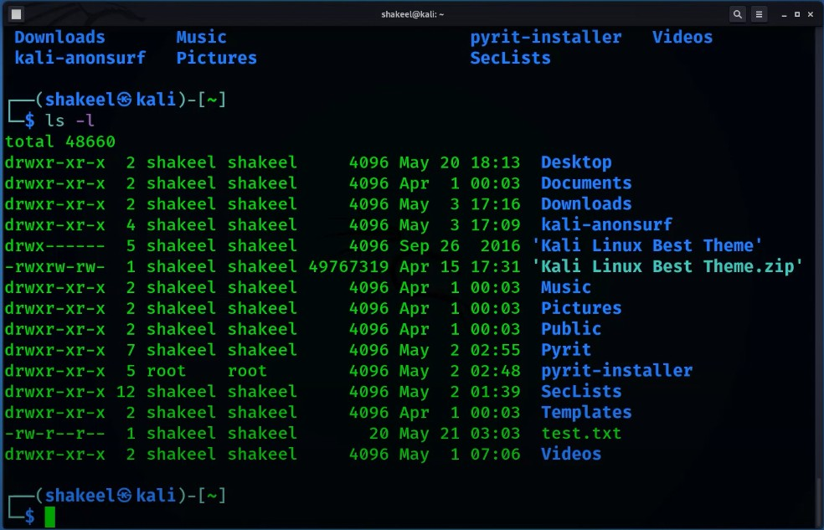
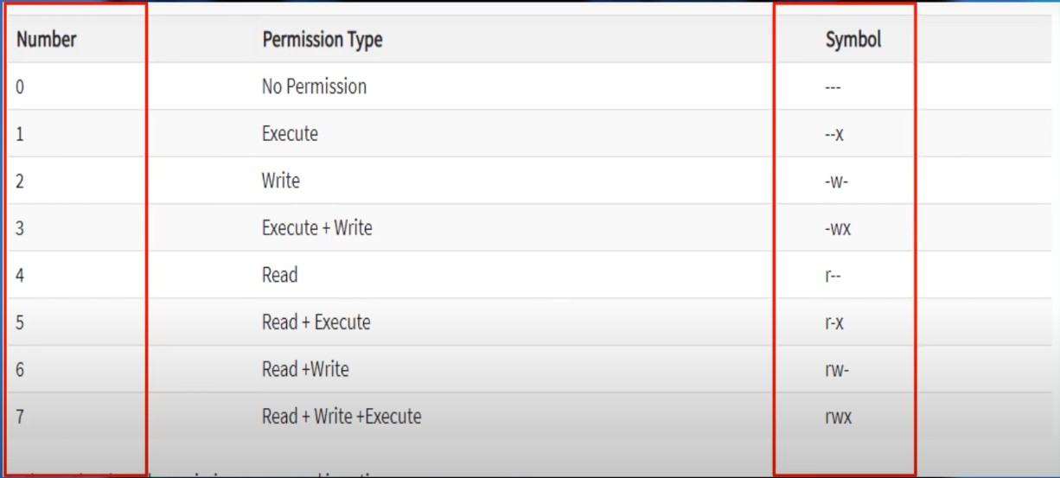
Read
Write
Execute
1. Sudu chmod 764 test.txt

Slide 49
Using grep, pipe & sorting of Kali Linux
Pipe Sign: | (Multiple command at a time)
Create a text file by cat > test.txt
View Insite the txt file: cat test.txt
Example:
Cat text.txt | echo “Tariqul” >> text.txt | cat text.txt, Grep Command (Text Search):
  Cat test.txt | grep Tariqul Sort Command:
  Sort test.txt
  Sort -r test.txt
Managing Processes &Task of Kali Linux
Processes: Series of action or steps to archive a perticular end or output.
ping (Command)
Poss a Command: ctrl shift z ( Poss a command)
fg ping (Continuer a process)
ctrl c (close a process fully)
top (Command) - Current Running Process
ctrl c (close a process fully)
sudo kill (Process ID) – Stop a process
ps us (Current User process)
How To Use SSH, FTP, TELNET on Kali Linux - Kali Linux
Ssh -h (Details)
Ssh ursername@192.168.0.0
Sudu rm -r folder name (to delete a folder)

Slide 50
ftp -h (Details)
ftp ip-192.168.0.0
ftp ? (for all option)
or ftp help (help Commant)
telnet (Plaintext)
telnet -h (Details)
telnet ip-192.168.0.0
Set IP Address & Internet in Kali Linux
ifconfig (Connected Device Details)
sudo ifconfig eth0 down (Down a port)
ifconfig (for check)
sudo ifconfig eth0 up (up a port)
sudo ifconfig wlan 192.160.0.104 (Manual IP Assign)
sudo ifconfig wlan netmask 255.255.255.0 (Subnet Musk Assign)
sudo ifconfig wlan broadcast 192.160.0.104 (Broadcast IP Assign)
ping command
Enumerate Users & System Info of Kali Linux
whoami (Linux User Name)
id (User ID, Group ID Details)
hostname (For Host Name)
sudo nano /etc/hostname (Host Name Change)
uname -a (Linux Operating Current Version)
hostnamectl (Kali Linux Details Information)
How To Install Software & Learn Kali Linux Tools

Slide 51
sudo apt install vlc (Software Install Command)
sudo apt search vlc (Available Tool Names)
nmap –help (Available Option of this/a tool)
man nmap (Manual of a tool)
q (Logout from details)
man ping (Manual of a tool)
whatis nmap (Summery of a tool)

Slide 52
Lecture Title:
Shell Scripting in Unix/Linux – Practical Approach Using Kali Linux
Introduction to Bash Shell in
UNIX/Linux
Bash Stands for “Bourne Again Shell” in the shell ecosystem. It is a free version of the Bourne shell distribution associated with the Linux and GNU operating systems. It is similar to the command-line shell with extra features incorporated, and bash is a speciﬁed part of IEEE POSIX. Bash Shell is widely available for operating systems and is a default command-line interpreter for almost all GNU/Linux systems. Bash also includes the features of Cshell and Kshell.
Understanding of Bash Shell in Linux
Let’s see the concept of bash shell in Linux as given below:
Shell: Shell is a macro processor allowing interactive or non-interactive command execution. It is completely based on the graphical user interface so that the user can interact with the underlying operating system.

Slide 53
Scripting: Scripting means a piece of code that enables automatic
command execution instead of manual intervention. It reduces human effort and the cost of implementation.
Kernel: It is the core of any operating system, which is used to communicate with the hardware and shell for information exchanges
Applications: These are the graphical user interface application used by the end-users.
🔹 1. What is a Shell?
A shell is a command-line interpreter that provides an interface between the user and the kernel.
Common shells:
  Bash (Bourne Again Shell) – most widely used
  sh, zsh, csh, ksh

Slide 54
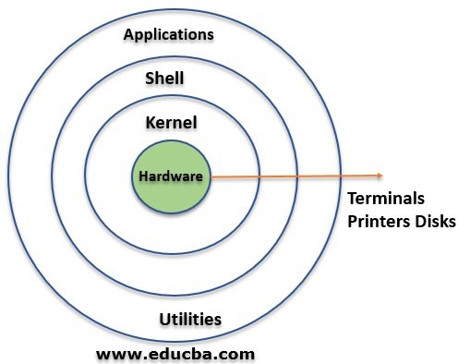
○
🔹 2. What is Shell Scripting?
A shell script is a text file containing a series of Unix/Linux commands.
Instead of typing commands one-by-one, you write them in a script to be executed as a program.
🔹 3. Why Shell Scripting in Unix/Linux?
Core part of Unix philosophy: “Do one thing and do it well”
Automate routine administrative tasks

Slide 55
Batch processing of files, logs, and system configurations
Automate security tools and testing (in Kali)
🔐 Penetration Testing
Shell scripts are used to:
Automate scanning tools like nmap, nikto, dirb
Chain multiple tools together (e.g., scanning + exploit execution)
Create custom payloads and automate their delivery
Schedule repeated tests (like cron jobs)
✅ Example: A script that runs an nmap scan every night and saves the result with a timestamp.
🐞 Bug Finding
Shell scripts can:
Run and monitor software automatically
Collect logs and system metrics during software testing
Simulate user inputs or actions to test edge cases
✅ Example: Script to run a program with different inputs to see where it crashes.

Slide 56
⚠ Error Detection
Shell scripting helps by:
Parsing log files to detect unusual behavior or known error patterns
Monitoring services and alerting if they stop
Automatically restarting failed services
✅ Example: A script that checks for error codes in /var/log/syslog
and emails the admin.

Slide 57
Lecture Title: Getting Started with Shell Scripting
Objectives:
After this session, students will be able to:
Understand what shell scripting is and why it's used
Create and edit shell scripts using the Nano editor
Check and modify script permissions
Execute scripts using both bash and ./ methods
Understand the importance of the shebang line
Theory Section
What is Shell Scripting?
Shell scripting is the process of writing a sequence of commands in a file to automate tasks in Unix-like systems. These scripts are commonly used for system administration, backups, automation, and more.
What is a Shell?
The shell is a command-line interface that allows users to interact with the operating system. Common shell types include sh, bash, and zsh.
What is a Shebang (#!)?
The first line of a shell script usually starts with a special sequence
called a shebang: #!/bin/sh
This tells the system which shell to use when executing the script. If

Slide 58
this line is missing, some execution methods (like ./filename.sh) may not work correctly.
Lab Section: Step-by-Step Instructions
Step 1: Open the Terminal and go to the Desktop Type the following command:
cd Desktop
Step 2: Create a New Shell Script File
To create a new file using Nano editor, type:
nano new.sh
This command opens the Nano text editor and creates a file named
new.sh.
Step 3: Write a Simple Script
Inside Nano, type the following lines:
#!/bin/sh
echo "Hello World"
echo "This is my first shell script!"
Step 4: Save and Exit Nano
Press Ctrl + O to save
Press Enter to confirm the file name
Press Ctrl + X to exit the editor
Step 5: Check the File in Desktop Type:

Slide 59
ls
If the file name appears in white color, it means it does not have execution permission.
Step 6: Check File Permissions Type:
ls -la
This will display the permission status of all files. You may see that
your script has -rw-r--r-- meaning it is readable and writable, but not executable.
Step 7: Make the Script Executable To give execution permission, type:
sudo chmod +x new.sh
It will ask for the root password. Type your password and press Enter.
Step 8: Verify Execution Permission Now type:
ls -la
You should now see -rwxr-xr-x for your script file, which means it has execute permission.
Step 9: Run the Script
You can run the script using either of the following two methods:
bash new.sh
./new.sh
Note: The second method (./new.sh) will only work if the shebang line #!/bin/sh is present at the top of the script.

Slide 60
Summary / Key Points:
Shell scripts are used to automate command-line tasks.
Always begin scripts with a shebang line to specify the interpreter.
Use Nano or other text editors to create .sh files.
Use chmod +x filename.sh to make a script executable.
Scripts can be run with bash filename.sh or
./filename.sh.
Homework / Practice Task:
Create a shell script named info.sh that does the following:
Prints your full name
Prints the current date and time
Lists all files and directories in the current location
Save and execute the script following the steps learned in this session.

Slide 61
Shell Script Banner Design
Lab Lesson: echo Command, Variable Declaration & Banner Design in Linux
🎯 Objective:
By the end of this lesson, students will be able to:
Use the echo command to print text
Declare and print string and integer variables
Design a basic text banner using shell scripting
🛠 1. Using the echo Command
The echo command is used to display text in the terminal. bash
CopyEdit
echo hello world echo "hello world" echo 'hello world'
Note: All three commands work the same. Using double quotes " or single quotes ' helps preserve spaces and special characters.

Slide 62
🛠 2. Printing Variables
String Variable:
bash CopyEdit
name="Nujao Mia"
echo "My name is $name"
Integer Variable:
bash CopyEdit
age=25
echo "I am $age years old"
Tip: There should be no space around the = sign when declaring variables.
🛠 3. Designing a Sample Banner
Use echo with symbols to make a simple banner. Example 1 (Single Line Banner):
bash CopyEdit

Slide 63
banner_text="Welcome to Linux Lab"
echo "============================="
echo " $banner_text "
echo "============================="
Example 2 (Multiline Banner): markdown
CopyEdit
echo "
*******************************
*
* Welcome to Linux Lab
*
*
*
*
*******************************
"
Optional Task: Let students design their own name banners using variables.
✅ Practice Tasks for Students:

Slide 64
Write a shell script that prints:
  Your full name
  Your age
  Your department name
Add a banner at the top of the output
Save the file as intro.sh
echo "enter your name"
read
echo "YOur Name IS" $REPLY
echo "enter your name"
read name
echo "YOur Name IS" $name

Slide 65
read - p "echo enter your name" fullname
echo "YOur Name IS" $fullname
Lab: User Input & Basic Scripting in Bash
🎯 Objective:
Learn to use the echo and read commands in Linux shell scripting. Understand different ways to take input and display output using variables. Design basic banners and menus in scripts.
🛠 1. Using the echo Command
The echo command is used to display text. bash
CopyEdit
echo hello world echo "hello world" echo 'hello world'
Note: Quotes help preserve spacing and special characters.
🛠 2. Printing Variables String Variable:

Slide 66
bash
CopyEdit
name="Nujao Mia"
echo "My name is $name"
Integer Variable:
bash CopyEdit
age=25
echo "I am $age years old"
🛠 3. User Input with read
Using default $REPLY:
bash CopyEdit
echo "Enter your name" read
echo "Your Name Is $REPLY"
Using a custom variable:

Slide 67
bash
CopyEdit
echo "Enter your name" read name
echo "Your Name Is $name"
Using -p to prompt inline:
bash CopyEdit
read -p "Enter your name: " fullname echo "Your Name Is $fullname"
🛠 4. Designing a Banner
Single-line banner using a variable: bash
CopyEdit
banner_text="Welcome to Linux Lab"
echo "============================="
echo " $banner_text "

Slide 68
echo "============================="
Multiline banner:
markdown CopyEdit
echo "
*******************************
*
* Welcome to Linux Lab
*
*
*
*
*******************************
"
✅ Practice Task
Create a script called userinfo.sh that:
Displays a custom banner
Asks for name, age, and favorite subject
Displays the result using echo
Run your script using:

Slide 69
nginx
CopyEdit
bash userinfo.sh
🖼 Final Example – Code from Image (Menu-Based Script)
bash CopyEdit
#!/bin/bash
echo "########################################"
echo "#
echo "# echo "#
#"
#"
#"
MY FIRST SCRIPT
echo "########################################"
echo "Enter 1 To Show IP"
echo "Enter 2 To Show MAC"
read -p "Select Your Option: " option
echo "You Select Option $option"

